Slide 1
Introduction to Graphics Programming and its Applications
繪圖程式設計與應用
Quiz 3 Buffer & Texture
Examination Time : 17:30~18:20 (50 mins)
Instructor: Hung-Kuo Chu
Department of Computer Science
National Tsing Hua University
CS4505

Slide 2
Objective
Transfer data to GPU and draw a textured model
Apply nearest filtering on texture
Your output must be 100% identical to TA’s
Vertex data in mesh_data.h and corresponding texture data in texture_data.h files! ( already included in quiz framework )

Slide 3
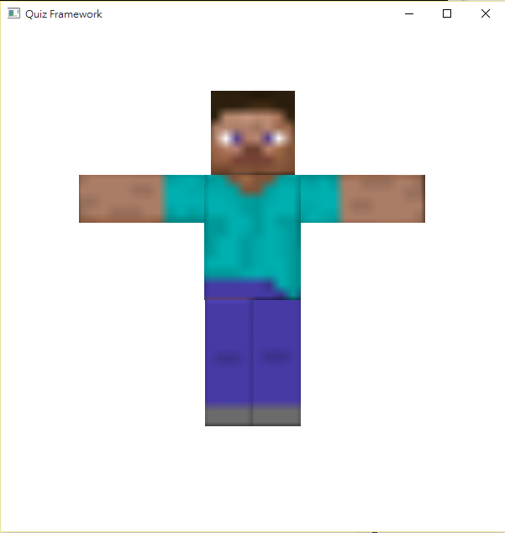
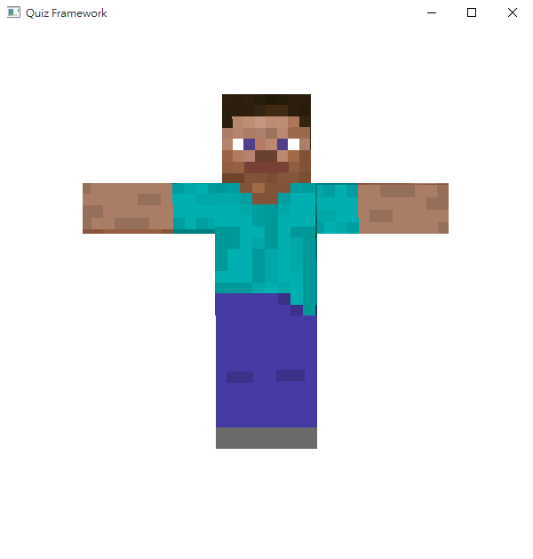
Objective
GL_TEXTURE_MAG_FILTER & GL_TEXTURE_MIN_FILTER
WRONG ANSWER
ACCEPTED ANSWER

Slide 4
Hint
You only need to modify main.cpp
Search “TODO” to find the section you need to code
Check both vertex and fragment shader may help you to find the solution

Slide 5
Hint
Key API Links:
glTexImage2D
glVertexAttribPointer
glTexParameteri

Slide 6
Hint
Step by step:
Generate (glGenBuffers), bind (glBindBuffer) and fill the buffer with data (glBufferData)
Assign buffer to vertex attribute (glVertexAttribPointer)
Enable vertex attribute array (glEnableVertexAttribArray)
Generate (glGenTextures), bind (glBindTexture), fill (glTexImage2D), and apply nearest filtering (glTexParameteri)
Pass the mvp matrix and the texture to shader uniform (glGetUniformLocation, glUniform*)
Issue draw call (glDrawArrays)

Slide 7
Hint
mesh_data.h format:
1200 floating point numbers, representing 80 triangles
Vertex positions(vec3) and texture coordinate values(vec2) are interleaved
Open the file and see for yourself!
Triangle
Vertex
Vertex
Vertex
Position
Texcoord
Position
Texcoord
Position
Texcoord

Slide 8
Hint
texture_data.h format:
6144 unsigned char numbers, representing a 64 * 32 * RGB image
Open the file and see for yourself!

Slide 9
Rules
You cannot:
Copy & paste others’ code
Ask others to code for you
Use internet, Google, StackOverflow, etc.
Discuss with your classmates nor TAs
You can:
Check any hangouts of this course
Demo your program window to TAs before you leave the PC room

Slide 10
Introduction to Graphics Programming and its Applications
繪圖程式設計與應用
Quiz 3 Buffer & Texture Answer
Instructor: Hung-Kuo Chu
Department of Computer Science
National Tsing Hua University
CS4505

Slide 11
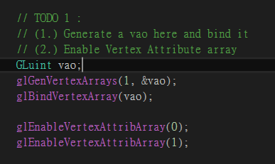
TODO 1
Generate a vao and bind it
Enable Vertex Attribute array

Slide 12
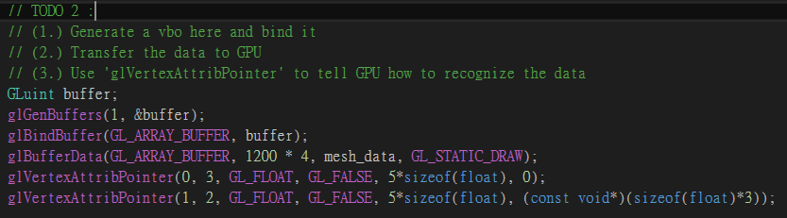
TODO 2
Generate a vbo and bind it
Transfer the data to GPU
Tell GPU how to recognize the data

Slide 13
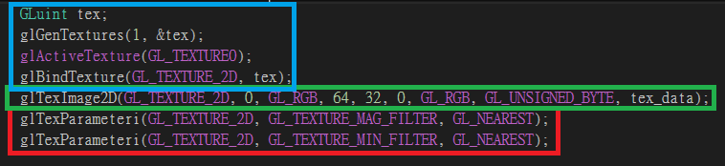
TODO 3
Generate a texture, then bind it and active it
Fill the texture with tex_data
Apply nearest filtering ( check p.3 comment )

Slide 14
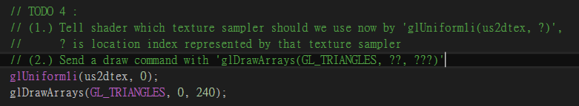
TODO 4
Tell GPU which sampler2D (in fragment shader) should being used now
Send a draw command

Slide 15
Q & A
Q : I can’t find the API, glTexImage2D, in course slides. I don’t know how to use it!!!
A : First, you should check the API link in the pdf. I won’t go into detail here but I will provide a briefly comment in the next slides.

Slide 16
glTexImage2D
glTexImage2D( target, level, internalFormat, width, height, border, format, type, data )
Target : we use 2D texture here, so this parameter should be GL_TEXTURE_2D
Level : specify LOD ( level-of-detail ), we don’t need to generate mipmap here, so we use 0
internalFormat : specify the number of color components in the texture, we use GL_RGB here

Slide 17
glTexImage2D
glTexImage2D( target, level, internalFormat, width, height, border, format, type, data )
(width,height) : We have already told u that (w,h) = (64,32) in page 8, so check it by yourself
Border : this value must be 0
Format : same as internalFormat in this case, we use GL_RGB here
Type : specifies the data type of the pixel data, after checking texture_data.h we found that the value ranges from 0~255 ( 8 bits = 1byte ), so we use GL_UNSIGNED_BYTE here
Data : Just the pointer of data

Slide 18
Q & A
Q : Why did I always draw the linear case?
A : You may forgot to apply nearest filter
Q : Why did I always draw the model filled with black pixels?
A : Your glTexImage2D parameter may wrong, or you might forgot to tell GPU which sampler2D to use now

Slide 19
Q & A
Q : What is the difference between glTexImage2D, glTexSubImage2D, glTexStorage2D?
A :
glTexImage2D : Able to assign blocks for texture and initialize the data (will create lots of data structure), better flexibility but with slowest speed
glTexSubImage2D : Suit for updating static texture data, but some of the parameters are not allowed to be changed ( size, pixel, format )
glTexStorage2D : Can only assign a block of memory for texture storage, very efficient to use with framebuffer.

Slide 20
Q & A
 | glTexImage2D | glTexSubImage2D | glTexStorage2D
Assign blocks | O | X | O
Initialize data | O | O | X
Update data | O | O | X
mutable parameters | O | O | X
If you want to draw a static texture : Use glTexStorage2D + glTexImage2D
If you want to draw a dynamic texture : Use glTexImage2D

Slide 21
Reminds
If you still don’t know about how to use glVertexAttribPointer, we suggest you go back to check the answer of Quiz 2

